Slide 1
Comparative study of Biodata, resume, and CV.

Slide 2
INTRODUCTION
Job Application writing
A job application letter (also known as a cover letter) is a letter you send with your resume to provide information on your skills and experience. This letter is your chance to “sell” yourself to an employer, explaining why you are an ideal candidate for a position.
Types of comparative study
• Resume
• CV
• Bio- data
RESUME
Resume is a word originated from the French word. Education, Skills & employment summarized together is called a Resume. A Resume is an outline of what you are and does not list down all Details of a profile, but showcases specific skills customized to the target job. For a fresher a resume generally starts with the Career objective, followed by education qualification, project Details, major skills, internships, workshop’ s, strengths, Interests, personal details etc. The best in you and are expertized to construct a resume which highlights the best in you.
CURRICULUM VITAE (C.V.)
Curriculum Vitae are words originated from a Latin word. CV contains details which are more relating to education and life. It is a more in depth details than a resume. It may be 2 – 3 pages or even longer depending on one’ s requirement. It covers all details in a chronological order. It covers general talent rather than specific skills for any specific positions.
BIO-DATA
Bio data is nothing but an old fashioned terminology for Resume or CV. Bio Data is the short form for Biographical Data and is an archaic terminology for Resume or C.V. In a bio data, the focus is on personal particulars like date of birth, gender, religion, race, nationality, residence, marital status etc. other than education and experience. At times Bio-data also includes applications made in specified formats as required by the company. The term bio-data is mostly used in India

Slide 3
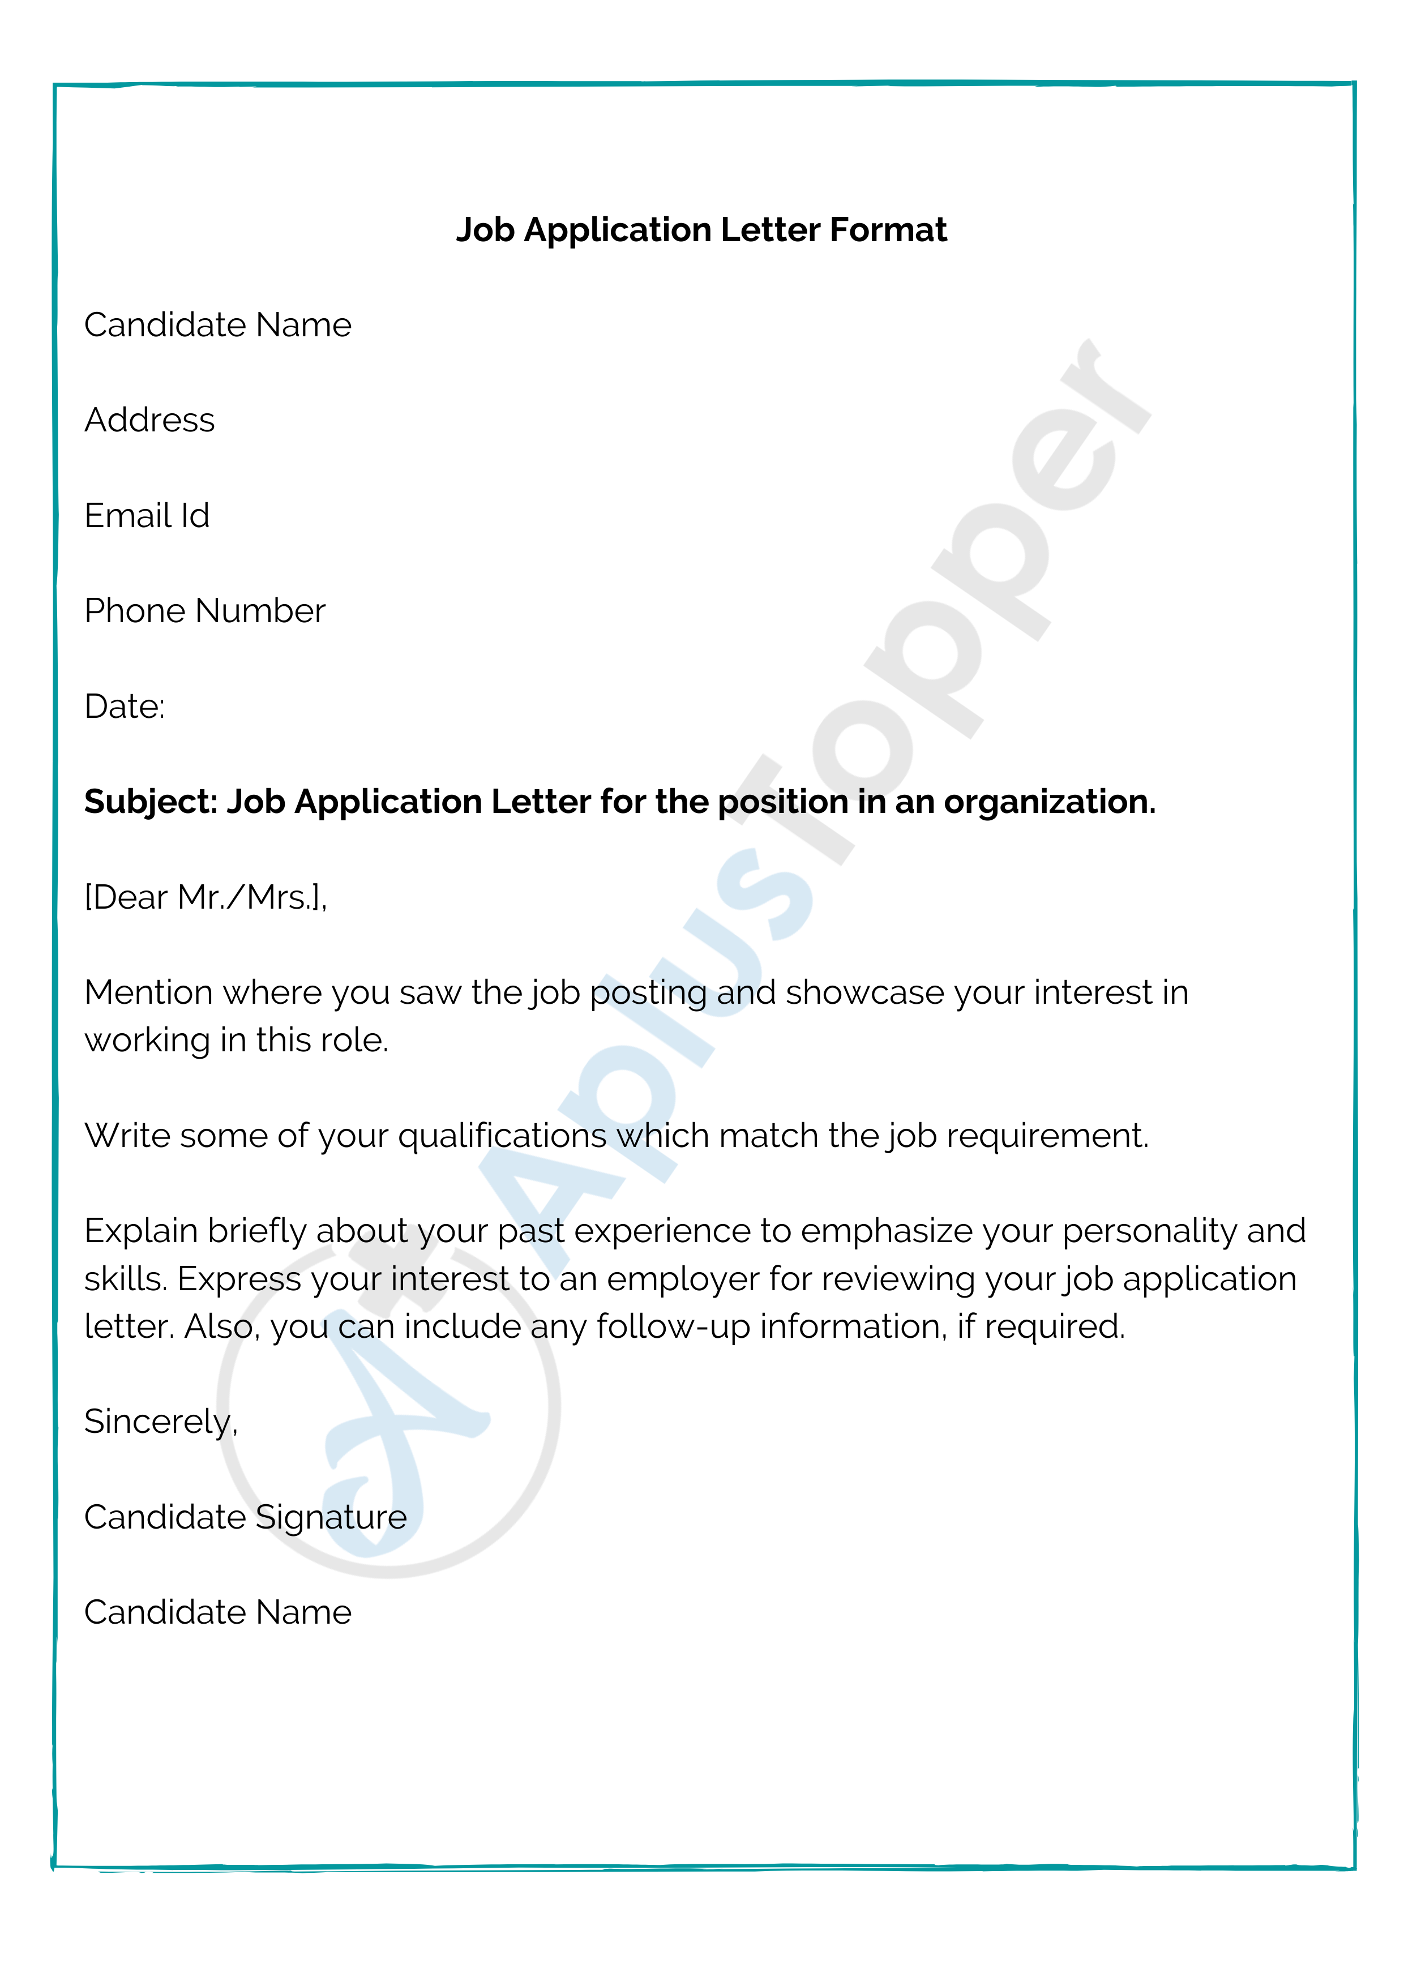
Application writing
It is a document that should be submitted along with the resume to an employer to express the candidate’s interest in the position while applying for jobs. It is also known as a Cover Letter. It explains why the candidate qualified for the position and should be shortlisted for an interview. Whereas the resume explains the candidate’s history of work experience, skills, and accomplishments. The letter should emphasize the candidate’s skills and key qualifications which is fit for the role.

Slide 4
Types of Application writing
Classical application
Online application
Unsolicited application
Brief application

Slide 5
Tips for writing a job Application letter
Tips for Writing a Job Application Letter
Do not copy your resume. A cover letter is a sales pitch …
Tailor each application letter to the job. ...
Be professional. ...
Carefully proofread. ...
Follow business letter format. ...
Decide whether to send a hard copy or email. ...
Employer Contact Information (if you have it) ...
Salutation.

Slide 6
Difference and similarities between Bio-data, Resume and CV.
Difference between Bio-data, Resume and CV
Similarities between Bio-data, Resume and CV
Bio-data:
Bio-data consists the information about the individual and attributes, hobbies, interests along with educational qualification to describe the person the best.
Resume:
A resume is a one or two page ”summary” of your skills, experience and education. Generally no more longer than a page or two. It indicate’s professional qualification.
CV:
A curriculum vitae is a longer and more detailed synopsis. Generally over a couple of pages long. It indicates candidate’s professional experience.
Are tailored for the specific job/company you are Applying.
Are both an overview of your accomplishments, experience and skills are used to get you an interview.
Old fashioned terminology used.
Archanic terminology used.
Educational qualification , experience of a person.
Academic career.

Slide 7
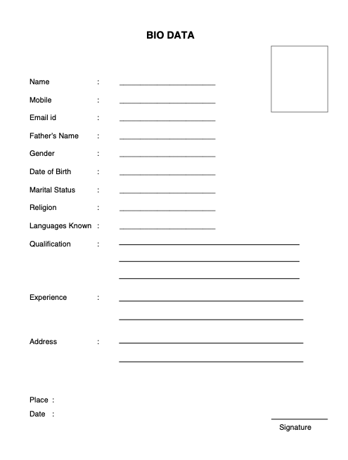
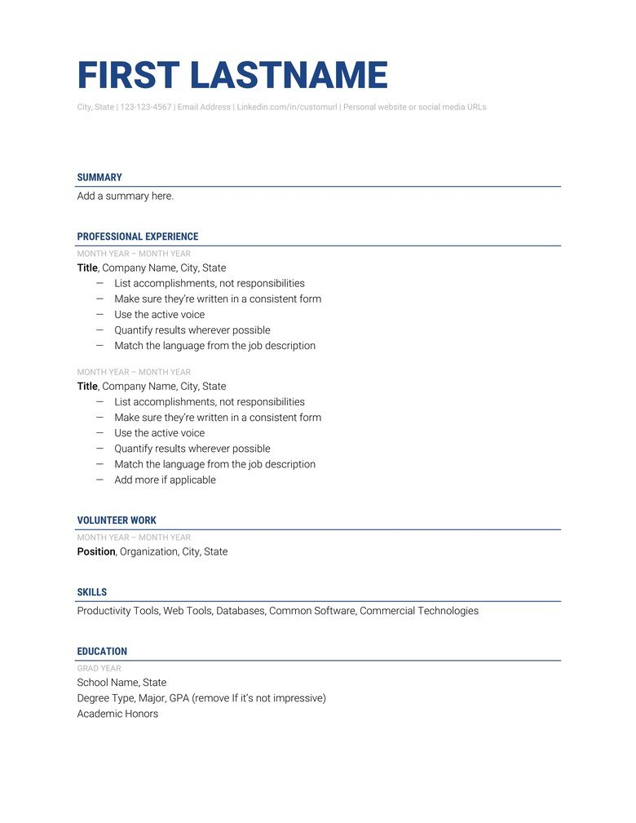
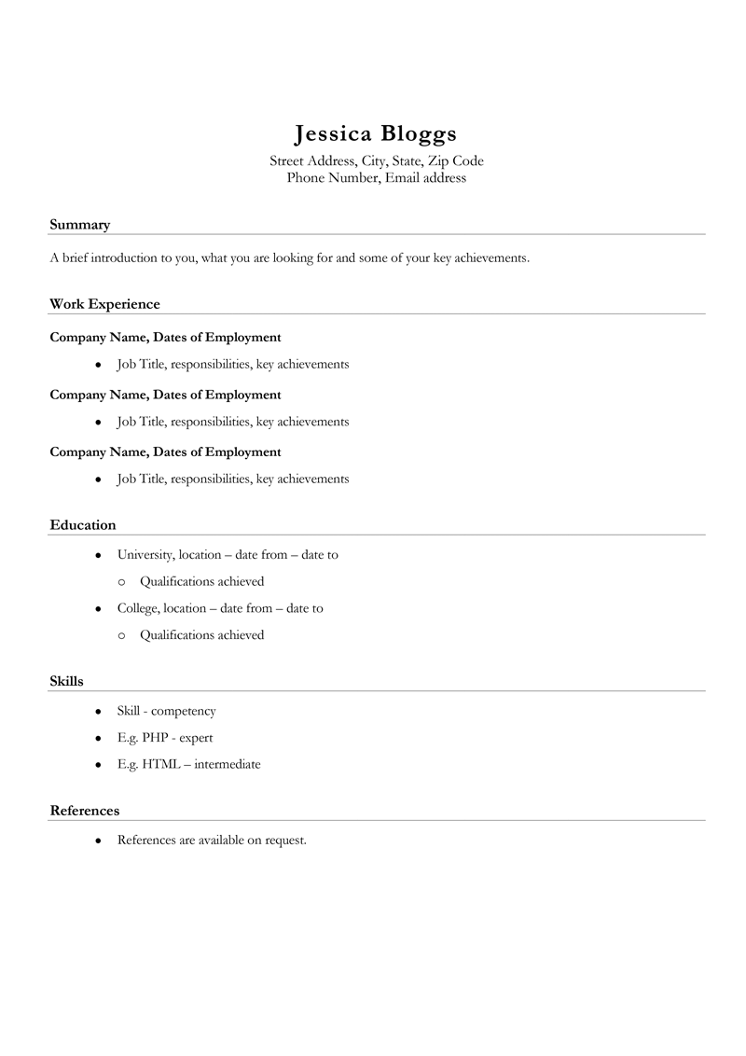
Formats/sample of Bio-data, Resume and CV

Slide 8
Conclusion
The project comparative study between Resume , Bio-data and CV conclude us in this project we came to know a actual difference and similaritis between Resume, Bio-data and CV . Also the unusual tern regarding these three can be also understood. Resume is the summery of the educational skill and used for employment to apply for a new job it should be usually one or two pages only whereas CV is more detailed and structured than resume it can be longer as per requirements and the last Bio-data is our self biographical data which reflect on piece of paper. It relates to only individual things such as name gender , date of birth , nationality, Residence, income etc.
the case study of this project is really helps too not only discard my misunderstanding about the CV, Resume, Bio-data but also it opens a door of actual structure of these 3 such as how they are written? What are the types of resume? And how build them stronger etc.

